Slide 1
Lecture 20: I/O
I/O hardware
I/O structure
communication with controllers
device interrupts
device drivers
streams

Slide 2
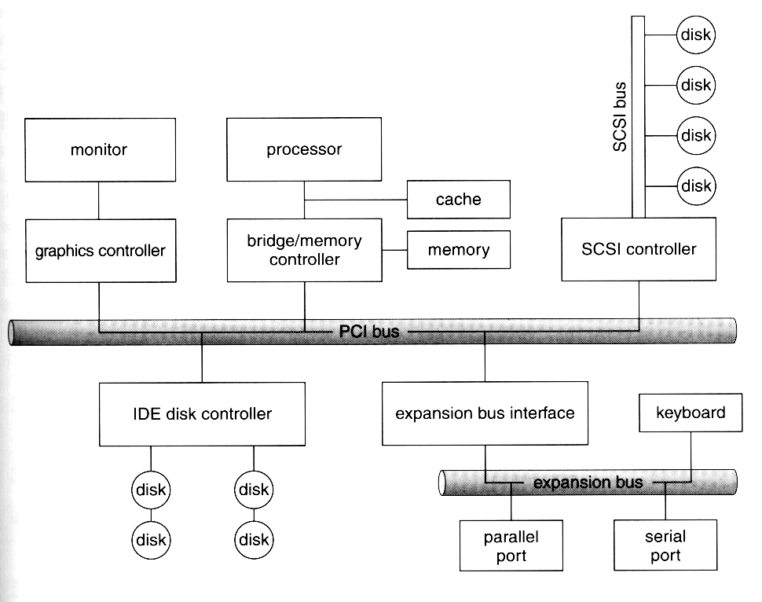
I/O hardware
bus - a set of wires
and a protocol that
defines the messages
that can be set over
the wires
controller - a collection
of electronics that
can operate a device
(a port, a bus, a hard
disk)
if controller is complex
it can be implemented as a separate circuit board called adapter
note that the controllers are located on both “sides” of the bus:
device controller - bus - host controller

Slide 3
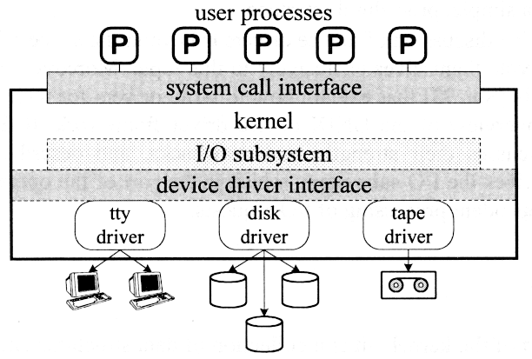
(Unix) I/O
Structure
To decrease complexity
of I/O design Unix I/O
management is layered
user applications
communicate with
peripheral devices via
the kernel through
system calls
I/O subsystem handles
the I/O requests and
uses the device driver interface to communicate with the devices
device driver is an independent part of the kernel that contains a collection of data structures and functions that controls one or more devices and interacts with the kernel through a well defined interface

Slide 4
Communication with controllers
Controller has a set of control and status registers (CSR)
CSRs are device-dependent
driver writes to CSRs to issue commands and reads them to obtain completion status and error information
two ways of I/O space configuration:
  separate I/O space - separate (CPU) instructions are needed to move data to and from controllers
  memory-mapped device I/O - CSRs are assigned regular memory addresses and data in CSRs can be manipulated by regular memory operations (like store and load); examples - video memory in PCs
two ways of transferring data between kernel and device:
  programmed I/O (PIO) - data has to be written to the device byte by byte. Whenever the device is ready for the next byte it issues an interrupt; examples - printers, modems, mice, keyboards
  direct memory access (DMA) – CPU just gives the description of the data to be transferred (location, size, etc.) and the DMA controller does the rest communicating with memory independently of CPU
    variant - direct virtual memory access (DVMA) – controller copies data between two memory-mapped devices

Slide 5
Polling and device interrupts
The kernel communicates with devices by:
  polling - CPU regularly polls CSRs of a device to check if the I/O operation has completed
  interrupts - a device raises an interrupt to alert the CPU that I/O operation has completed
interrupt handler - a short self-contained routine that responds to an interrupt
interrupts can be:
  polled - there is one interrupt handler that upon startup checks all the devices to see which of them needs attention
  vectored - the device is assigned to a specific interrupt handler and a interrupt vector table is kept. The vector contains the addresses of interrupt handlers by the interrupts. When an interrupt is raised the vector is consulted by hardware (rather than CPU) and the corresponding interrupt handler is started

Slide 6
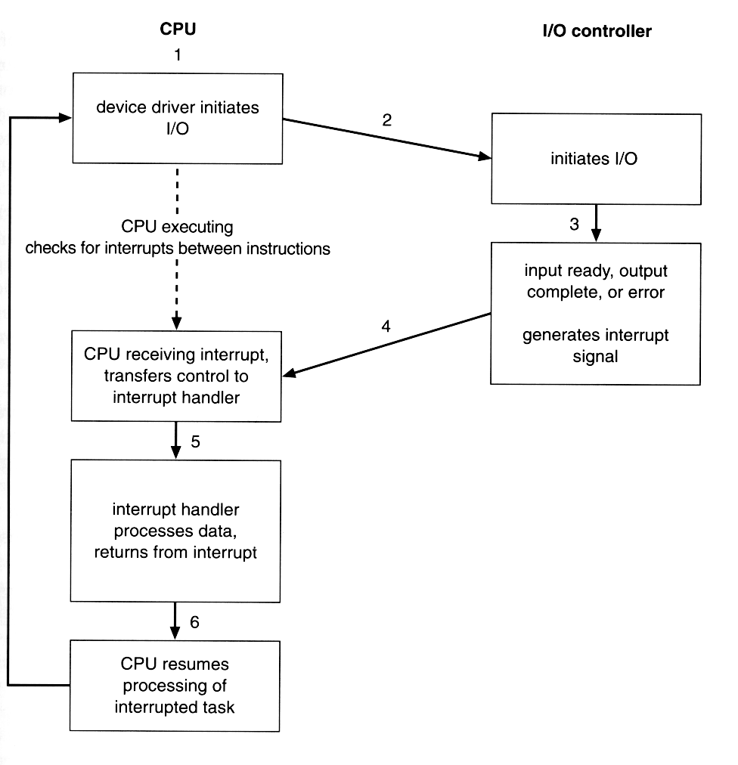
Interrupt flowchart

Slide 7
(Unix) device drivers
there is a variety of external devices and ways of communicating with them, to simplify programming – use device drivers
  device driver – kernel module that is coded to communicate with a particular device
from the I/O subsystem’s perspective the device driver is
“black box” that supports a standard set of operations
(each device may implement these operations differently)
Unix supports two device types
  block - stores data and performs I/O in fixed-size, randomly accessible blocks; examples - hard disks, floppy drives,
  CD-ROMs; due to the structured nature of the I/O operations on block devices efficient cache/buffering algorithms can be used;
  character - can store and transfer arbitrary sized data. May transfer one byte at a time (generating an interrupt after every byte) or perform some internal buffering; examples - keyboard, mouse, clock, modem

Slide 8
Why STREAMS?
Kernel interacts with drivers at a very high level leaving the device driver to do most of I/O processing. It provides flexibility of the design, yet only part of the work of the driver is hardware dependent; the other part - high-level I/O processing: queue management, buffering, caching, etc. Every vendor writes their own device drivers
  code duplication
    large kernel
    greater risk of conflict
  complex drivers
This problem is especially apparent in network driver design: network protocols are complex and designed in (interchangeable layers); this suggests a modular approach to driver design

Slide 9
STREAMS
STREAMS - a full-
duplex (bidirectional)
data transfer path
between a driver
and a user application
Consists:
  module - consists
  of a pair of queues:
    read - pass data
    (in the form of
    messages)
    upstream - to
    application
    write - pass messages downstream - to device
  stream head - handles system calls, may block
  driver end - handles interrupts, communicates to actual device
except for stream head the modules communicate asynchronously:
module code may be executed in the context of different process

Slide 10
Reusing modules
TCP/IP protocol stack
consists of a layers of
protocols where an
entity on one layer
communicates with
a peer entity on the
same layer and
provides services to
the upper layer
protocol
and utilizes services
of the lower layer
without concern to its internal structure
using streams modules can be assembled to fit the network configuration: note how IP module is reused

Slide 11
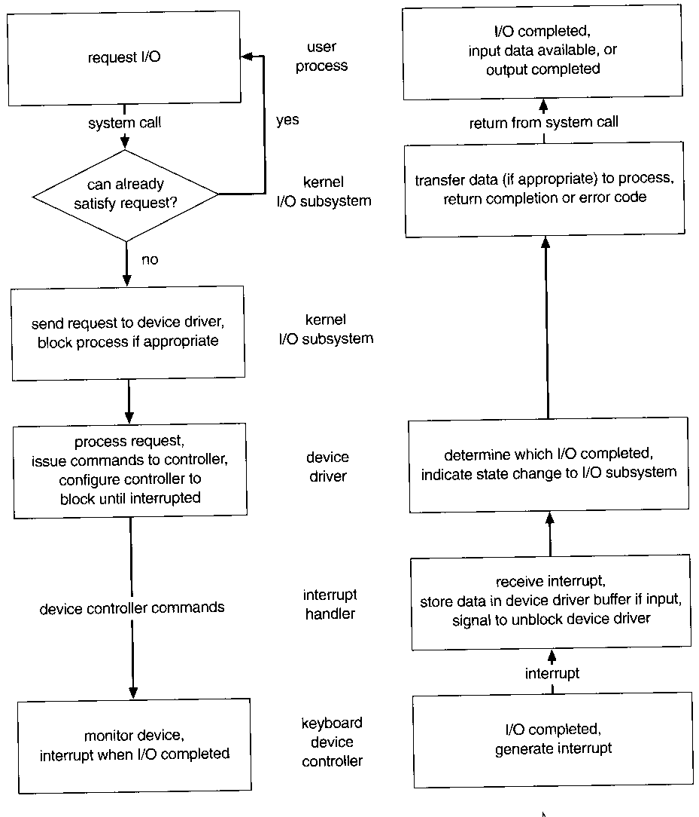
I/O request flowchart and hierarchy

